Slide 1

EvemtVista
Online Event Planner

Slide 2

INTRODUCTION
Welcome to the Event Management Project presentation.
This project is designed to simplify and enhance the process of event planning and management.
Effective event planning is crucial for success in various industries, and our project aims to address key challenges.
4

Slide 3


PROJECT SCOPE
Event creation, registration, and management.
User accounts and authentication.
Responsive design for various devices.
Vendor updating event organization details
Security
User - Vendor Interaction
4

Slide 4
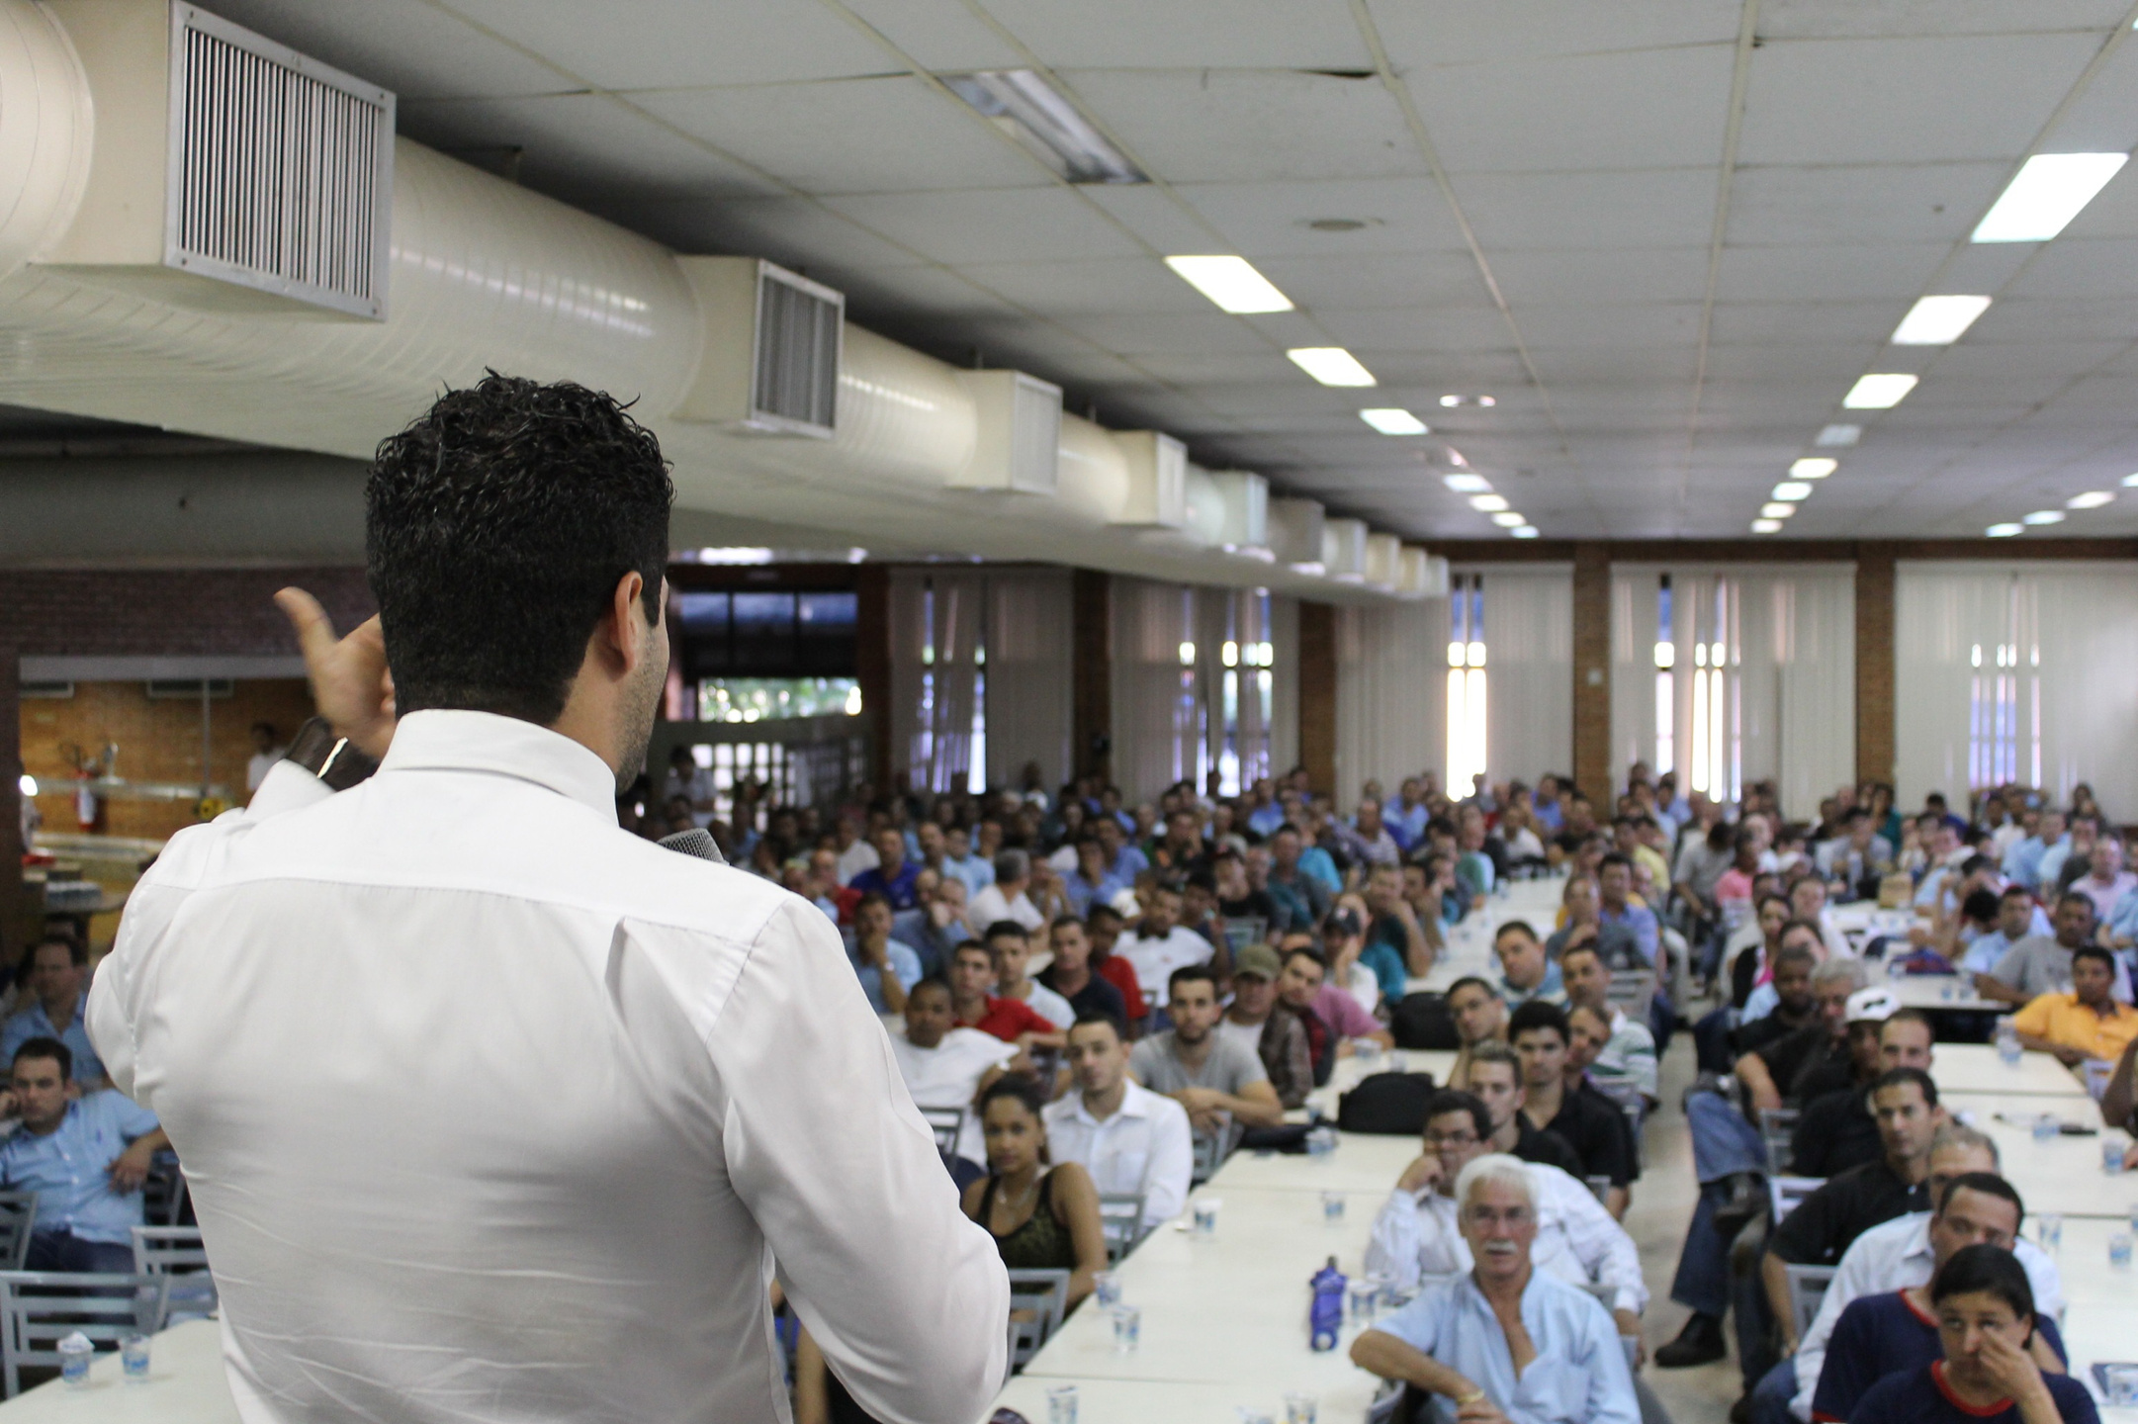
TECHNOLOGIES
Backend: Java
Database: MySQL
Frontend: HTML, CSS, JavaScript, Bootstrap
4

Slide 5

FEATURES & Functions FUNCTIONALITY
User Registration and Authentication
Event Creation and Management
Event Registration for Users
Event Listing and Details
User Account Management
Vendor Registration
Vendor - User Interaction
Admin Roles
4

Slide 6



PACKAGES
BASIC
CLASSIC
PREMIUM

Slide 7

CONCLUSION
In conclusion, our Event Management Project is a valuable tool for event organizers and attendees alike.
It simplifies event planning and provides a better user experience.
We look forward to future enhancements and further success.
4

